Slide 1
Disorder of parathyroid gland
I.HYPOPARATHYRODISM Hypoparathyroidism is a disorder in which the parathyroid glands in the neck do not produce enough parathyroid hormone (PTH).

Slide 2
Causes of hypoparathyroidism
Children | Adult
Accidental removal of a parathyroid gland when thyroid is removed
Part of parathyroid tissue removed during surgery
Increased absorption of calcium
Very low magnesium level in the blood (reversible)
Absent parathyroid glands from birth | Renal failure accompanied with phosphate retention
Radioactive iodine treatment for hyperthyroidism (very rare)

Slide 3
SYMPTOMES OF HYPOPARATHYRODISM
Symptoms may include any of the following:
Tingling lips, fingers, and toes (most common)
Muscle cramps (most common)
Muscle spasms called tetany (can affect the larynx, causing breathing difficulties)
Abdominal pain
Abnormal heart rhythm
Brittle nails
Cataracts
Calcium deposits in some tissues
Decreased consciousness

Slide 4
Dry hair
Dry, scaly skin
Pain in the face, legs, and feet
Painful menstruation
Seizures
Teeth that do not grow in on time, or at all
Weakened tooth enamel (in children)
Hyperexitability of nerves, accompanied by painful spasms of face, hands, arms and feet, a disease known as Tetany.
Severe cases are accompanied by contraction of muscles, particularly muscles of extremities, generalized convulsions and contraction of laryngeal muscles that airway is abstracted, leading to cyanosis and if prolonged , fatal asphyxia is produced.

Slide 5
Treatment
The goal of treatment is to reduce symptoms and restore the calcium and mineral balance in the body.
Treatment involves calcium carbonate and vitamin D supplements. These usually must be taken for life. Blood levels are measured regularly to make sure that the dose is correct.
A high-calcium, low-phosphorous diet is recommended.
Injections of PTH may be recommended for some people.

Slide 6
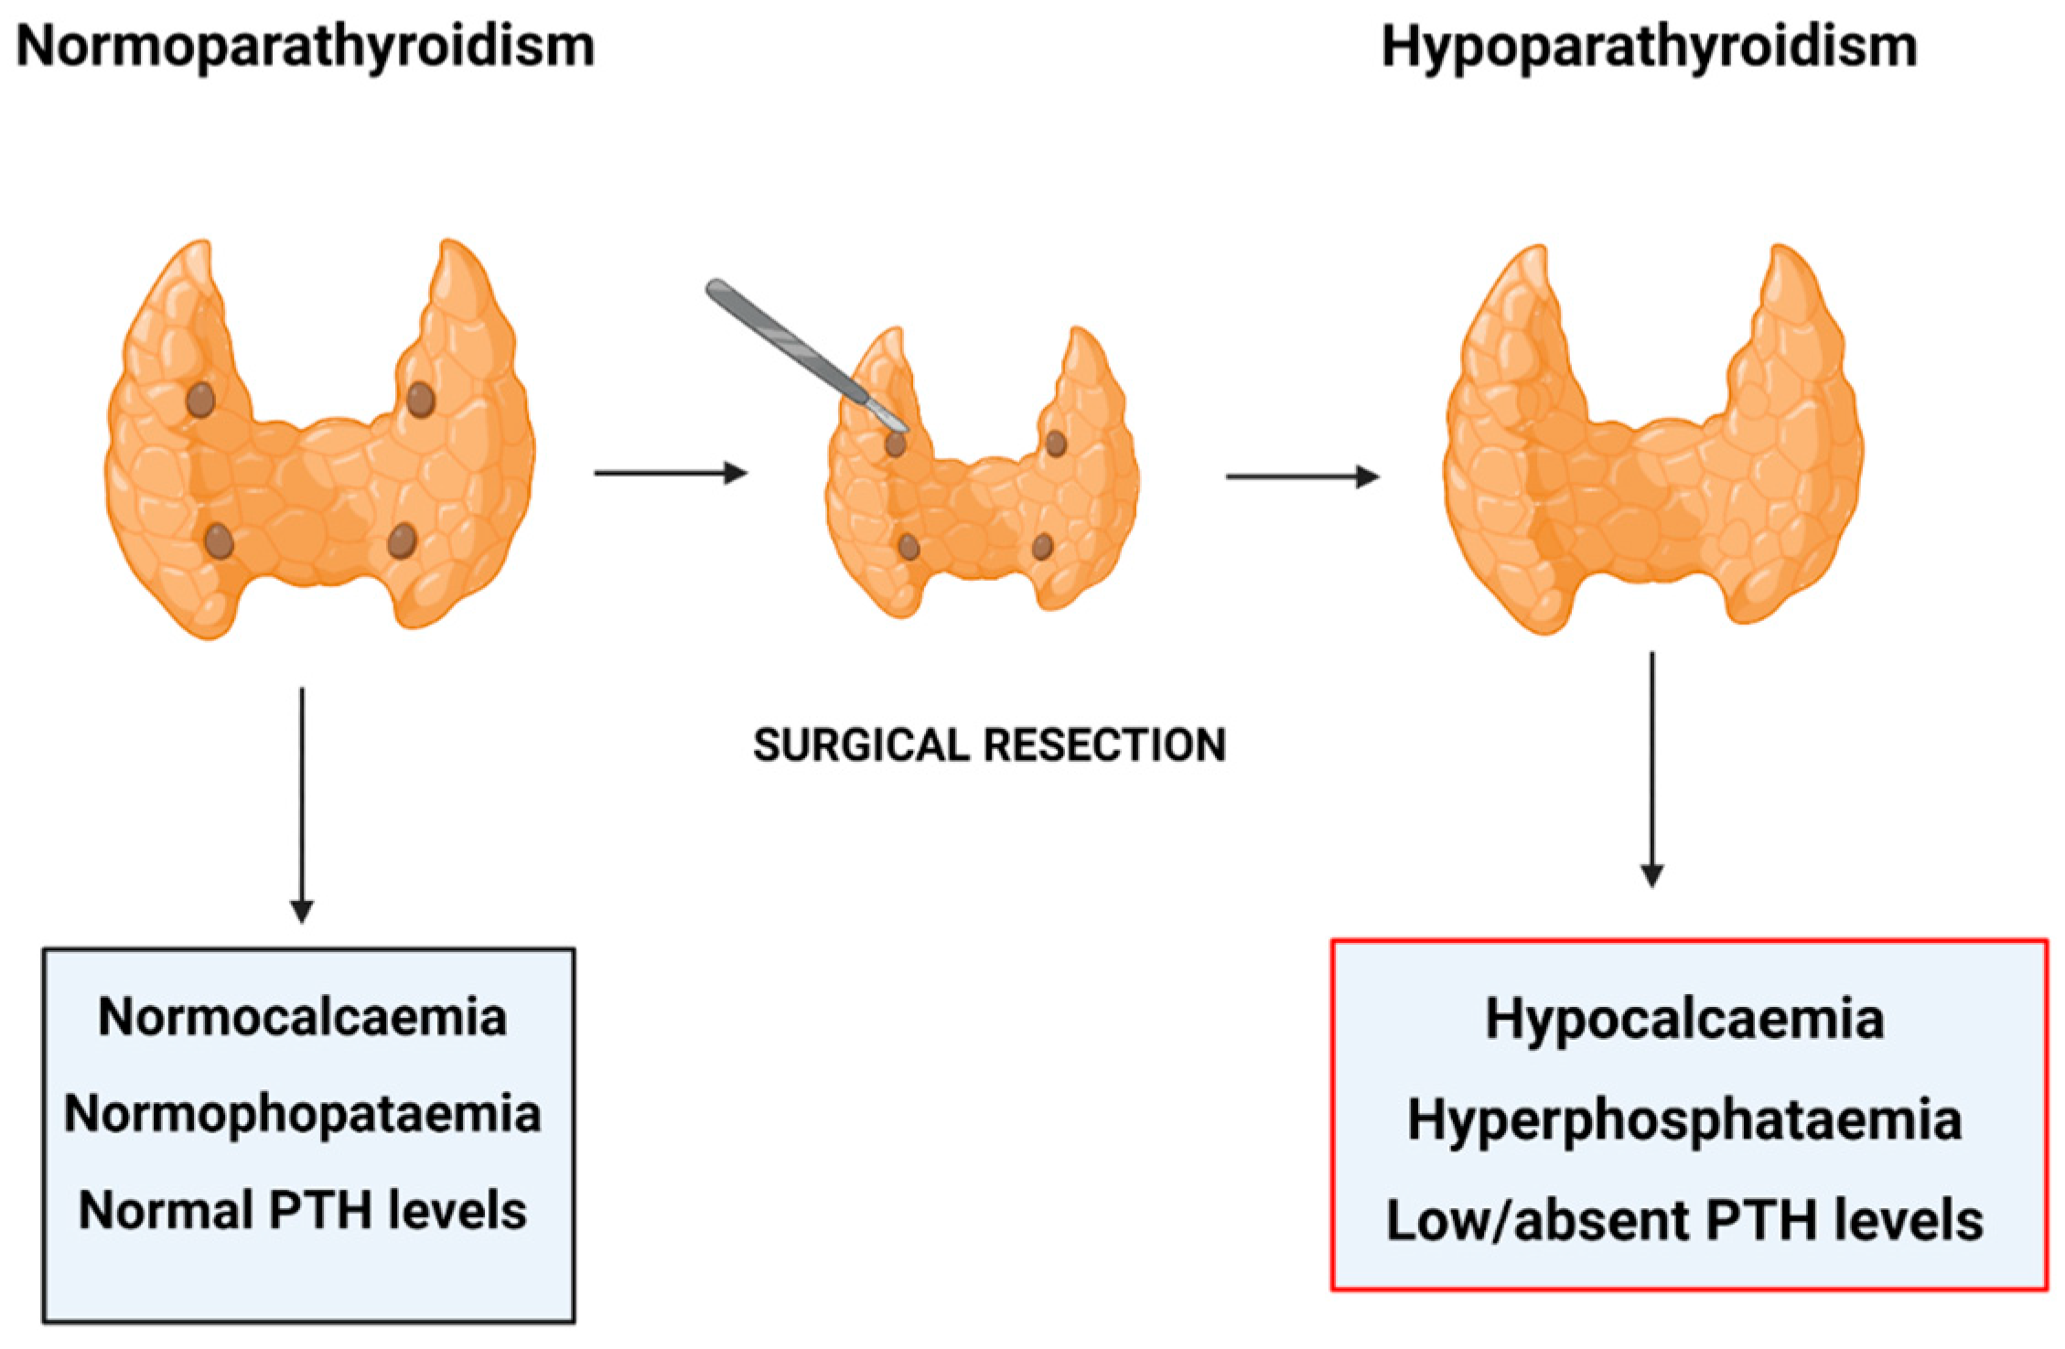

Slide 7
II-HYPERPARATHYROIDISM Hyperparathyroidism is where the parathyroid glands (in the neck, near the thyroid gland) produce too much parathyroid hormone.
Symptoms of hyperparathyroidism
depression
tiredness
feeling thirsty and peeing a lot
feeling sick and losing your appetite
muscle weakness
constipation
tummy pain
loss of concentration
mild confusion

Slide 8
There are 3 types of hyperparathyroidism.
Primary hyperparathyroidism is when there's a problem within the parathyroid gland itself, usually a benign (non-cancerous) tumour of the gland.
Secondary hyperparathyroidism is when the glands are fine but a condition, like kidney failure, lowers calcium levels and causes the body to react by producing extra parathyroid hormone.
Tertiary hyperparathyroidism is when long-standing secondary hyperparathyroidism starts to behave like primary hyperparathyroidism.
Tertiary hyperparathyroidism is often associated with very advanced kidney failure (usually requiring dialysis).

Slide 9
PRIMARY HYPERPARATHYROIDISM
In 4 out of 5 cases, primary hyperparathyroidism is caused by a non-cancerous tumour called an adenoma on one of the parathyroid glands.
Less commonly, it can occur if 2 or more parathyroid glands become enlarged (hyperplasia).
Very rarely, primary hyperparathyroidism can be caused by cancer of a parathyroid gland.
Women are more likely to develop primary hyperparathyroidism than men, and most people who develop it are over 60.

Slide 10
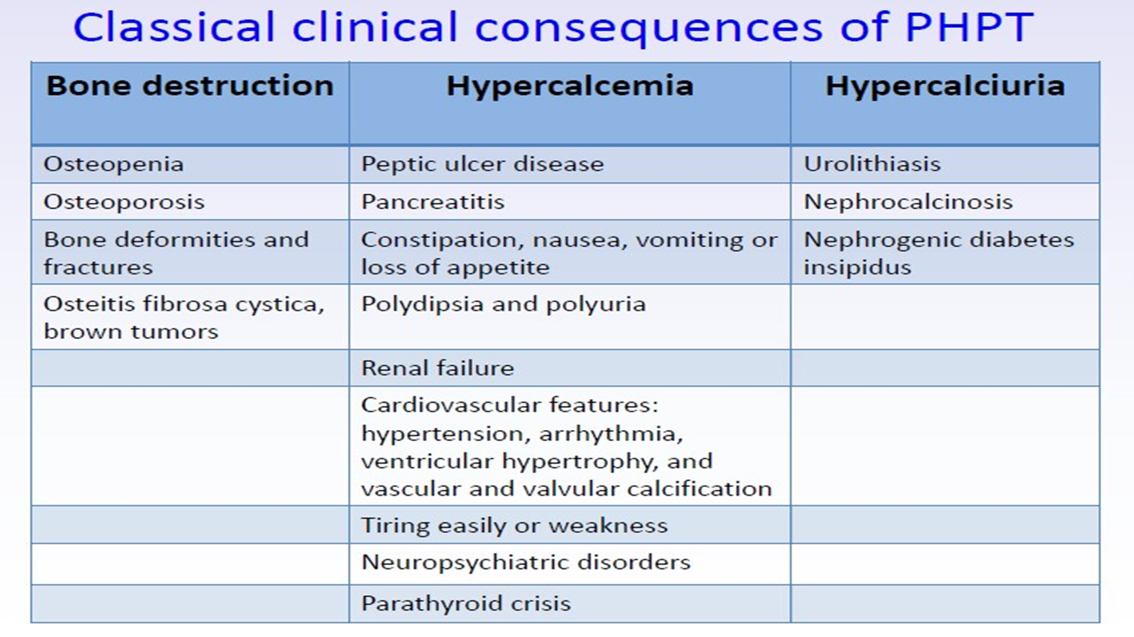

Slide 11
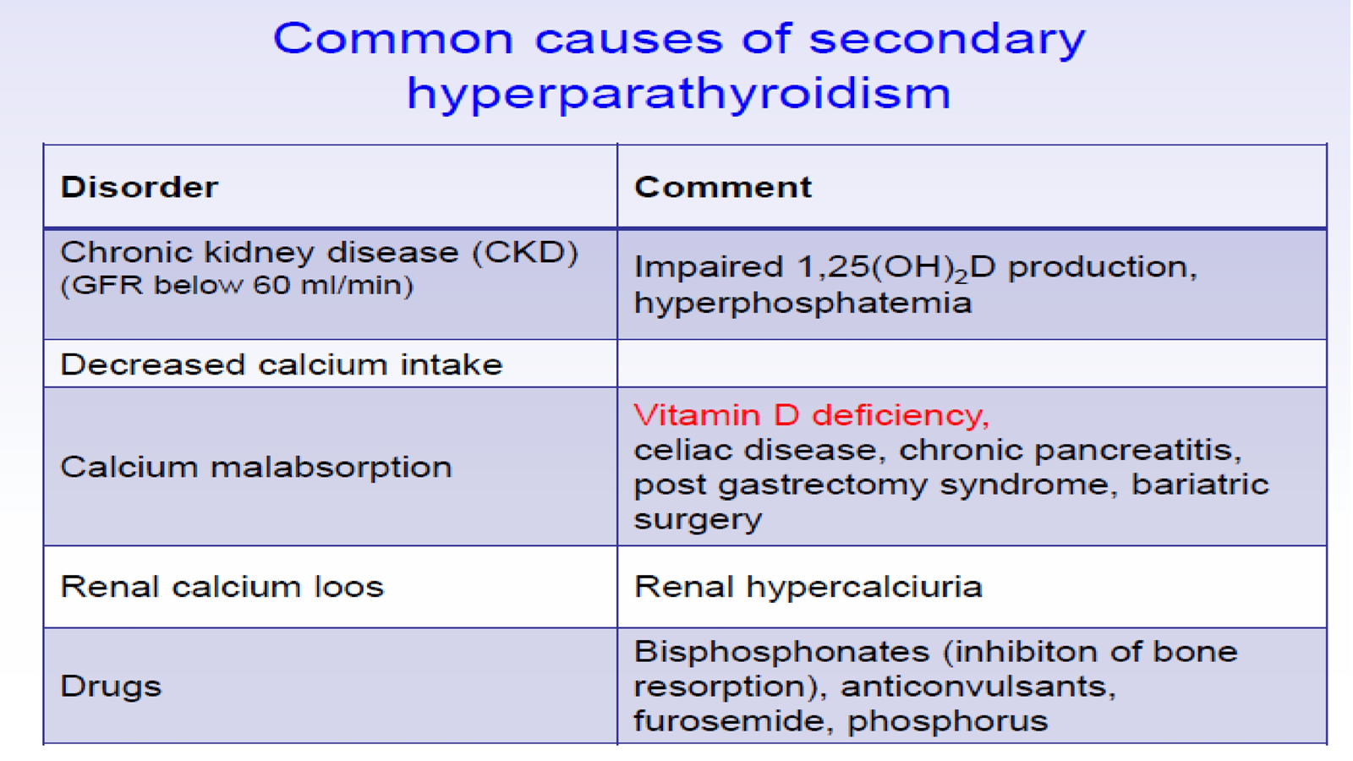

Slide 12
Treating primary hyperparathyroidism
Surgery to remove the parathyroid gland is usually the only way of treating primary hyperparathyroidism.
If calcium levels are very high, may need to be admitted to hospital urgently if patient have lost a lot of fluids (dehydration). patient may need to have fluids through an intravenous drip.
Treating secondary hyperparathyroidism
Treatment for secondary hyperparathyroidism depends on the underlying cause.
Low vitamin D is the most common cause and can be corrected with oral vitamin D (colecalciferol).
Treating tertiary hyperparathyroidism
Surgery is usually the main treatment for tertiary hyperparathyroidism that occurs in very advanced kidney failure.

Slide 13
